Slide 1

Post-Quantum Cryptography (PQC)
School of Computer Science and Engineering
Department of Computer Science and Engineering
Submitted By:
Swoyam Kumar Behera
2427030137
Supervised By:
Dr. Satyabrata Roy

Slide 2
Outline
Introduction
Literature Review
Problem Statement
Solution !!!
Objectives
Results !!!

Slide 3
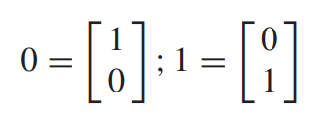
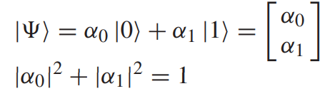
Introduction: Quantum Computing
Moore’s Law: In 1975, Gordon Moore predicted that transistors in integrated circuits will double after every eighteen month.
Quantum computation and quantum information is the study of the information processing tasks that can be accomplished using quantum mechanical systems.
Quantum computation is built upon an analogous concept, the quantum bit, or in short qubit.
Fig. 1 Matrices representing bits 0 and 1
Fig. 2 Eq. depicts state of a single qubit in matrix form and Dirac notation.

Slide 4
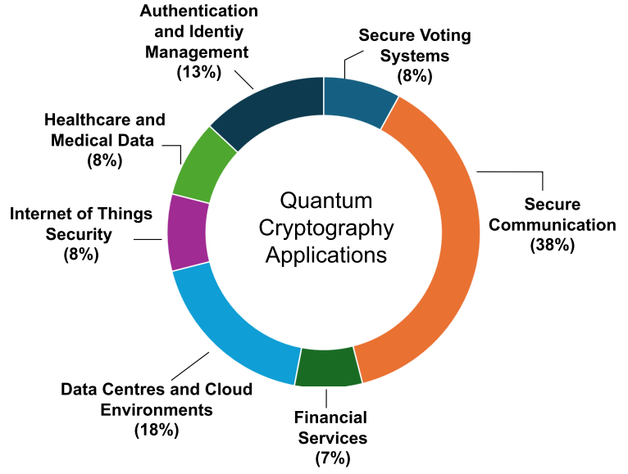
Introduction: Quantum Cryptography
QC achieves unparalleled levels of security by making use of basic aspects of quantum mechanics as opposed to traditional encryption which is based on mathematical algorithms and keys.
Theoretically, QC seems to provide a major advance in the realm of data security. However, no cryptographic technique can guarantee complete security.
Post-Quantum Cryptography: Symmetric and asymmetric cryptographic algorithms are vulnerable to quantum algorithms. Grover’s search algorithm gives a square root time boost for the searching of the key AES and 3DES.
Applications of quantum cryptography

Slide 5
Literature Review
Research Paper: | Points:
OLIVA DEL MORAL et al. | Modern cryptography distinguishes two types of cryptosystems depending on how a message is encrypted: 1) symmetric and 2) asymmetric key schemes
Durr-E-Shahwar et al. | Symmetric and asymmetric cryptographic algorithms are vulnerable to quantum algorithms. Grover’s search algorithm gives a square root time boost for the searching of the key AES and 3DES.
OLIVA DEL MORAL et al. | PQC refers to classical cryptographic methods based on hard problems whose solution cannot be found in polynomial time by neither classical nor quantum computers.

Slide 6
Literature Review
Research Paper: | Points:
V. Kumar, John Bosco Balaguru Rayappan, R. Amirtharajan et al. | In cyber security, cryptography and scientific simulations, random numbers play a significant role. A crucial mandate for information security is a high-quality, high-speed random number.
 | Even when the core algorithms are secure, in the interim, randomness generation with poor implementations would uncover severe security gaps for cryptosystem.
BHAT ET AL. | Utilizing the method of quantum key distribution, a random secret key is established for cryptography. Any attempt of manipulating will alter the state and can be detected making the communication secure without complex procedures and algorithms

Slide 7
Problem Statement
Hypothesis: While quantum cryptography provides theoretically superior security compared to classical cryptography, practical implementation challenges currently limit its widespread adoption.

Slide 8
Objectives
To review and compare existing research on quantum random number generation techniques highlighting their principles and performance.
To analyze the strengths, limitations, and security aspects of current methods as reported in recent literature, especially in terms of randomness quality and practical deployment.
To identify research gaps and future directions based on trends and challenges.

Slide 9
Methodology
Procedure: Quantum True Random Number Generation
Input: No of qubits, shots; Run the kernel;
Output: random numbers;
Step 1. Log in to the IBM quantum computer
Step 2. Enter into the quantum launch lab
Step 3. Launch server
Step 4. Qiskit 0.29.0
Step 5. Import standard Qiskit libraries
Step 6. Set the number of quantum registers and classical registers

Slide 10
Methodology
Step 7. Apply Hadamard gate to all qubits
Step 8. Apply measurement to all qubits
Step 9. Run cell by cell
Step 10. Enter the number of qubits
Step 11. Specified the number of qubits as 24
Step 12. Enter the number of shots
Step 13. Specified the number of shots as 65,536 Step 12. Number of random numbers = No of qubits * No of shots End procedure

Slide 11
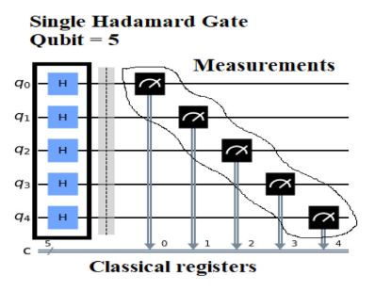
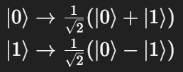
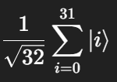
Methodology
Initially, all 5 qubits are prepared in the ground state:
|00000⟩
A Hadamard (H) gate is applied individually to each of the 5 qubits.
The Hadamard gate transforms each qubit as:
After applying H to all 5 qubits, each qubit enters a superposition state.
The combined 5-qubit state becomes:
An equal superposition of all possible 32 states.
Mathematically, the final state is:
Fig. 3 Single Hadamard Gate(Qubit=5)

Slide 12
Result
The National Institute of Standards and Technology(NIST) statistical test comprises of fifteen tests methods:
T1 –Frequency Test (Monobit)
T2 – Frequency Test within a Block
T3 –Run Test
T4 – Longest Run of Ones in a Block
T5 –Binary Matrix Rank Test
T6 –Discrete Fourier Transform (spectral) Test
T7 –Non-overlapping Template Matching Test
T8 –Overlapping Template Matching Test
T9 - Maurer’s Universal Statistical Test
T10 –Linear Complexity Test
T11-a –Serial Test 1 T11-b –Serial Test 2
T12 –Approximate Entropy Test
T13-a –Cumulative sums (forward) Test T13-b -Cumulative Sums (reverse) Test
T14- Random Excursion Test
T15- Random Excursions Variance Test

Slide 13
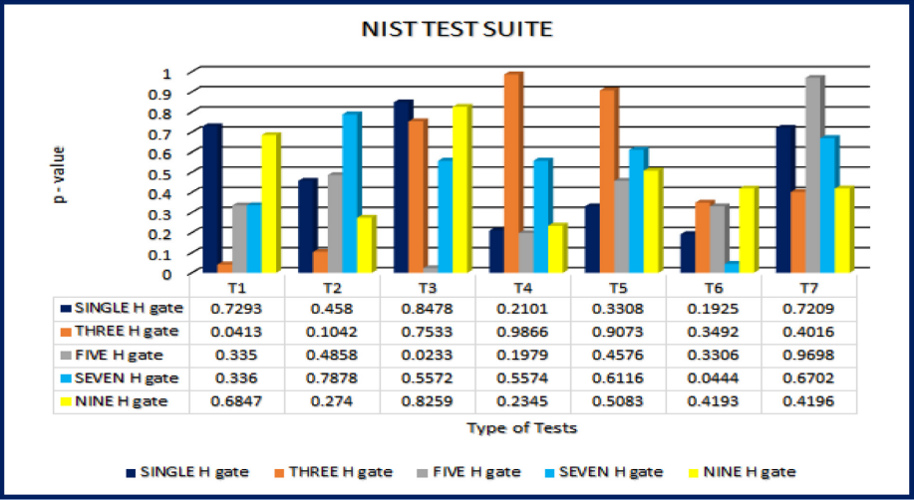
Result
Fig. 4 NIST 800–22 Statistical Test Result Test 1–7

Slide 14
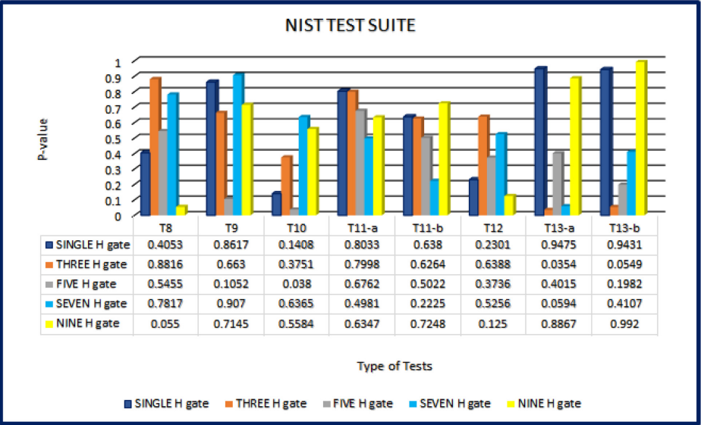
Result
Fig. 5 NIST 800–22 Statistical Test Result Test 8–13.

Slide 15
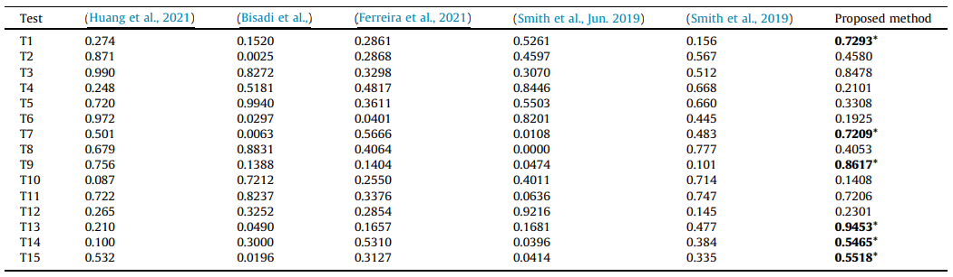
Result
Fig. 6 Performance comparison of proposed QTRNG with available literature.

Slide 16
Outcome
Research Paper (Drafted)
Prepared and drafted a research paper based on the literature survey, summarizing key findings, comparisons, and critical analysis.

Slide 17
References
Imran, Muhammad, Ahmed B. Altamimi, Wilayat Khan, Shariq Hussain, and Mohammad Alsaffar. "Quantum cryptography for future networks security: A systematic review." IEEE Access 12 (2024): 180048-180078.
Bhat, Hilal Ahmad, Farooq Ahmad Khanday, Brajesh Kumar Kaushik, Faisal Bashir, and Khurshed Ahmad Shah. "Quantum computing: fundamentals, implementations and applications." IEEE Open Journal of Nanotechnology 3 (2022): 61-77.
del Moral, Javier Oliva, Antonio deMarti iOlius, Gerard Vidal, Pedro M. Crespo, and Josu Etxezarreta Martinez. "Cybersecurity in critical infrastructures: A post-quantum cryptography perspective." IEEE Internet of Things Journal 11, no. 18 (2024): 30217-30244.
Kumar, Vaishnavi, John Bosco Balaguru Rayappan, Rengarajan Amirtharajan, and Padmapriya Praveenkumar. "Quantum true random number generation on IBM’s cloud platform." Journal of King Saud University-Computer and Information Sciences 34, no. 8 (2022): 6453-6465.
Bisadi, Zahra, Fabio Acerbi, Giorgio Fontana, Nicola Zorzi, Claudio Piemonte, Georg Pucker, and Lorenzo Pavesi. "Compact quantum random number generator with silicon nanocrystals light emitting device coupled to a silicon photomultiplier." Frontiers in Physics 6 (2018): 9.
Ferreira, Maurício J., Nuno A. Silva, Armando N. Pinto, and Nelson J. Muga. "Characterization of a quantum random number generator based on vacuum fluctuations." Applied Sciences 11, no. 16 (2021): 7413.
Huang, Leilei, Hongyi Zhou, Kai Feng, and Chongjin Xie. "Quantum random number cloud platform." npj Quantum Information 7, no. 1 (2021): 107.
Smith, Peter Raymond, Davide G. Marangon, Marco Lucamarini, Z. L. Yuan, and A. J. Shields. "Simple source device-independent continuous-variable quantum random number generator." Physical Review A 99, no. 6 (2019): 062326.

Slide 18
Thank You

